Slide 1
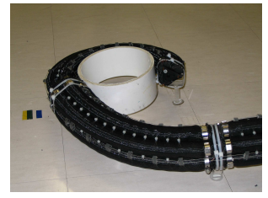
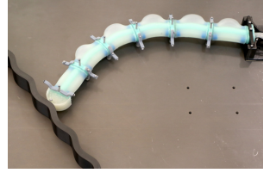
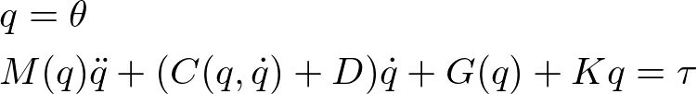
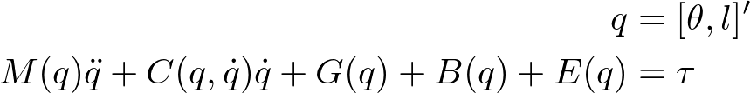
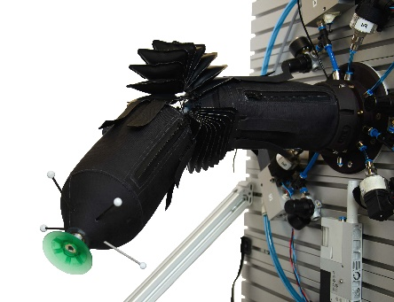
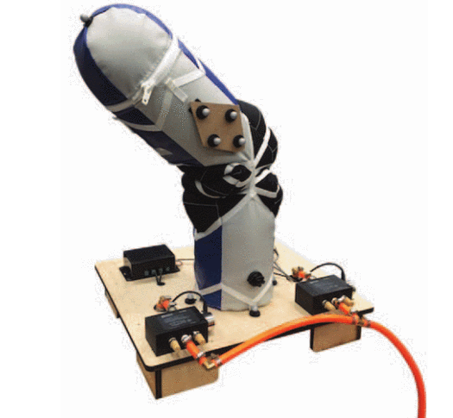
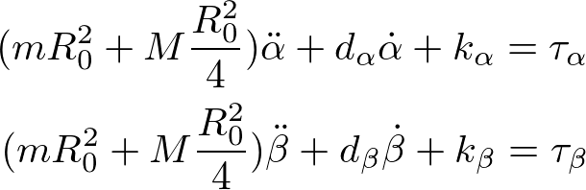
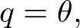
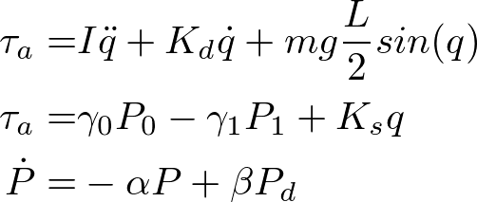
Prof. Daniela Rus’s group (2020)
Prof. Ian Walker’s group (2010)
System dynamic model with inextensible layer in the middle
System dynamic model
Curvature dynamic control with uncertainties but input uncertainties is not included
Sliding model control without considering input and damping uncertainties
Prof. Marc D. Killpack’s group (2015)
Prof. Raffaello D’Andrea’s group (2020)
System dynamic model (inverted pendulum)
System dynamic model (two pendulums)
A linear gain-scheduling feedback controller together with iterative learning control
MPC controller without gravity term

Slide 2
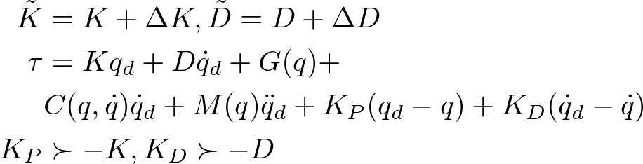

Related work in model-based dynamic control
Prof. Daniela Rus’s group (2020)
Curvature dynamic control with uncertainties
System dynamic model where G, K, D represents the effects of gravitational energy, material spring and damper effects
Limitations:
Framework only works for backbone located at the centerline
System uncertainties due to input signal is not included
No estimation for external disturbance

Slide 3
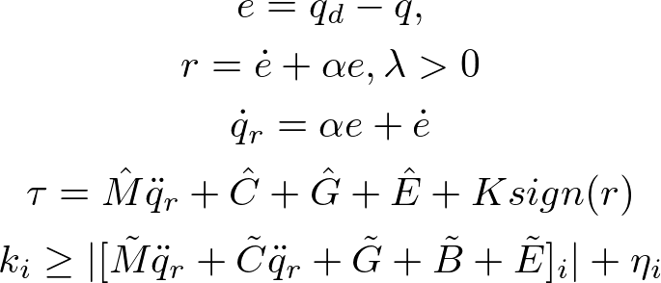
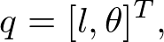

Related work in model-based dynamic control
Prof. Ian Walker’s group (2010)
Sliding model controller design
The error reaches the sliding surface in finite time and the state variables reach desired values exponentially fast.
System dynamic model where G, B, E represents the effects of gravitational energy, potential energy due to bending and extension
Limitations:
Assumes a backbone in the middle of the arm
System uncertainties due to damping effect and input signal is not included
No external disturbance estimation
Notes:
Three cables were used to map from task space to joint space

Slide 4
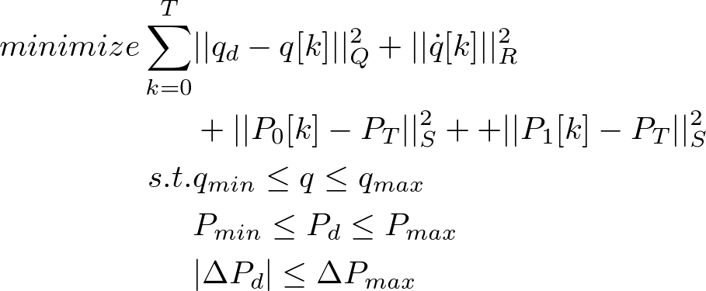
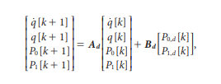
Related work in model-based dynamic control
Prof. Marc D. Killpack’s group (2015)
MPC controller design
System dynamic model (inverted pendulum)
Limitations:
The actuator needs to be specifically designed to fit the model requirements.
Gravitational term is ignored

Slide 5
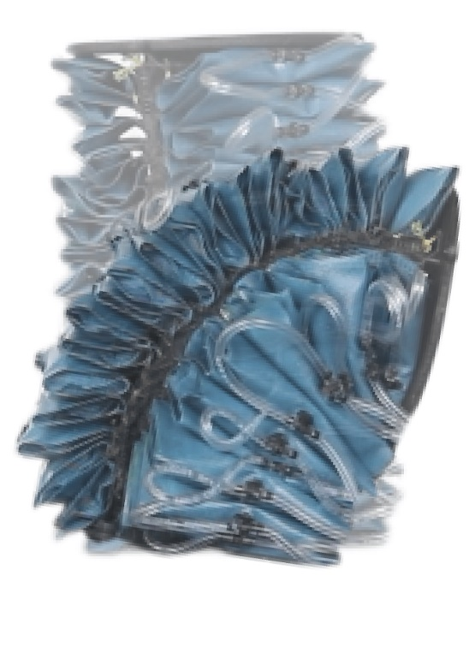
Sliding mode control with nonlinear disturbance observer and state switch (SMCWNDOS)
Develop augmented-rigid arm model for fabric-pillow-based actuator without backbone
Design a baseline SMC method for SISO system path tracking
Design a disturbance observer to reduce the input chattering and estimate lumped disturbance
Experimental results for contact and no contact cases

Slide 6
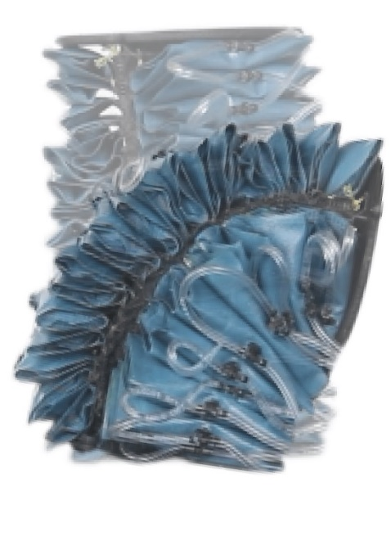
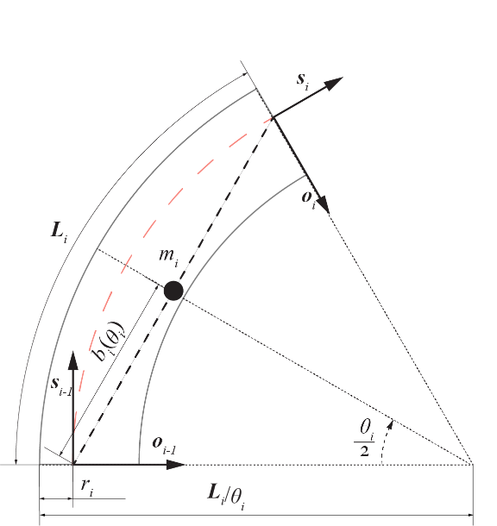
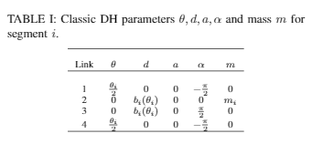
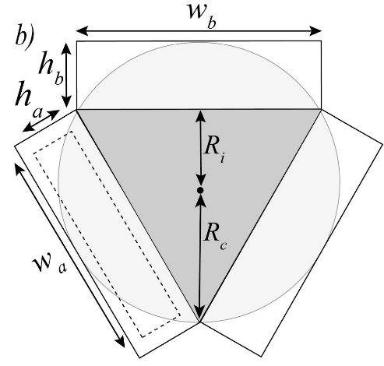
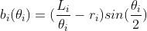
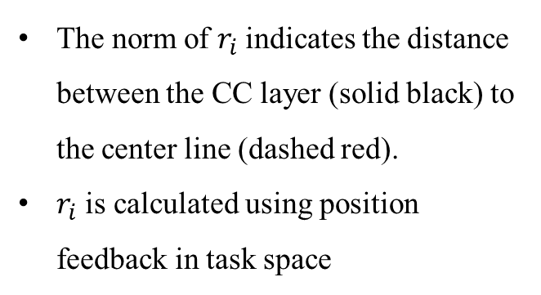
Augmented-rigid Arm Model
Fabric-pillow-based arm:
Hollowed in the center but with inextensible layer
Serial connected pillow actuators
The norm of $r_{i}$indicates the distance between the CC layer (solid black) to the center line (dashed red).
$r_{i}$ is calculated using position feedback in task space

Slide 7
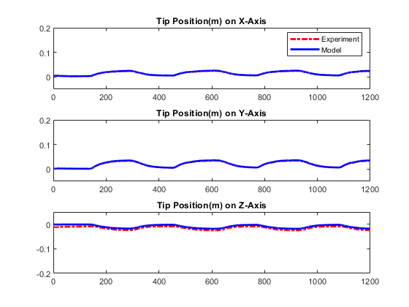
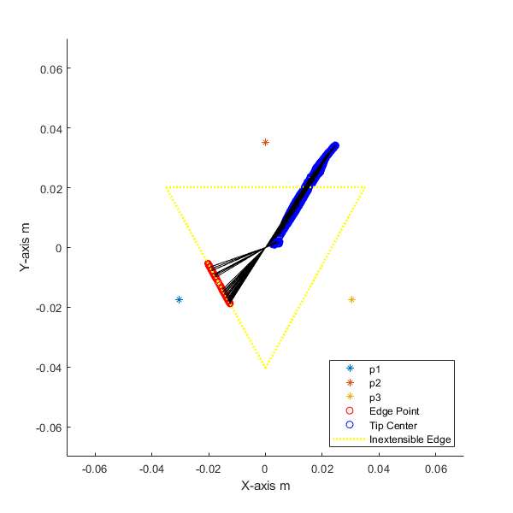
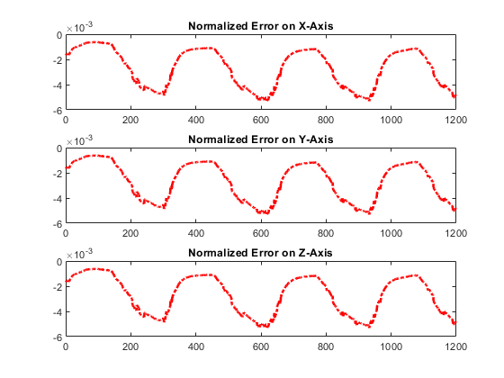
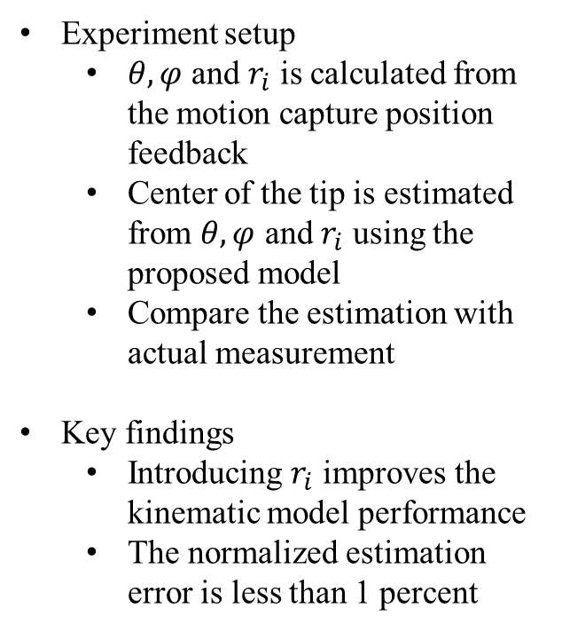
Forward Kinematic Results
Experiment setup
$θ,φ$ and $r_{i}$ is calculated from the motion capture position feedback
Center of the tip is estimated from $θ,φ$ and $r_{i}$ using the proposed model
Compare the estimation with actual measurement
Key findings
Introducing $r_{i}$ improves the kinematic model performance
The normalized estimation error is less than 1 percent
Experimental results. (Left) update rule
(Right) position errors in task space

Slide 8

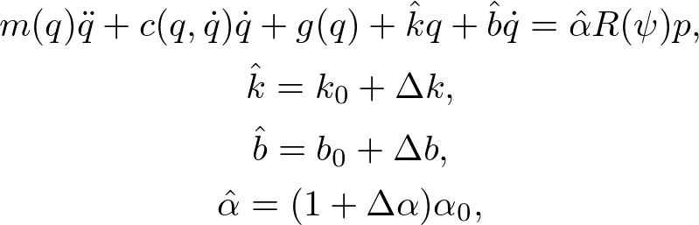
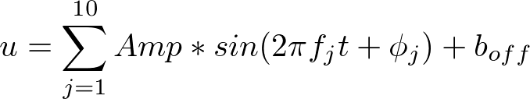

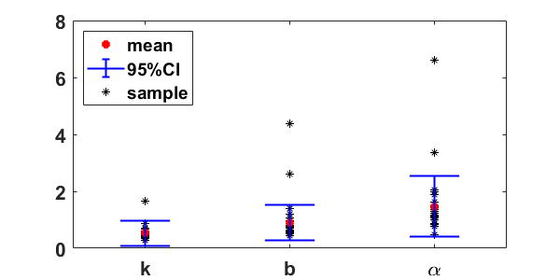
Dynamic Model with Parameter Uncertainties
Full system dynamics
System with bounded uncertainties
System Identification
Excitation Signal
Total trials: 30
Trial duration: 30 sec
System ID results

Slide 9
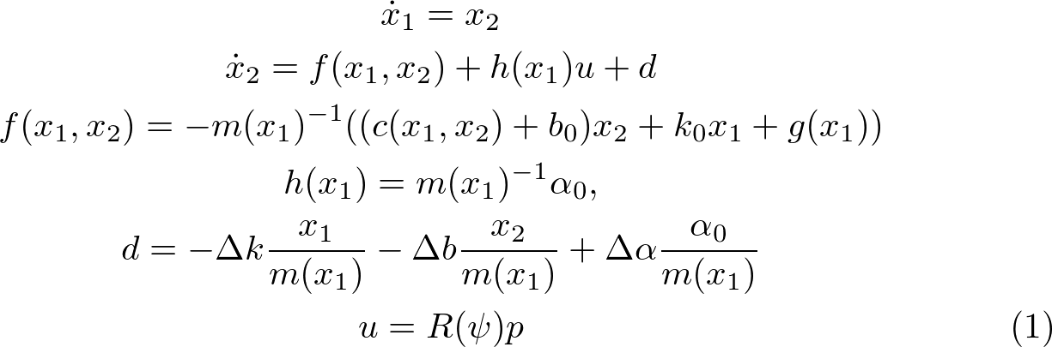
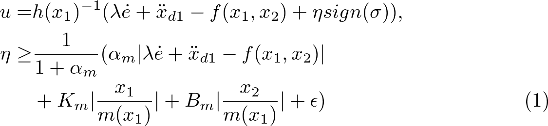

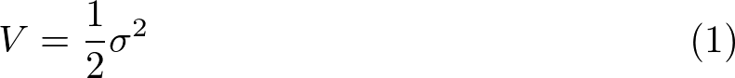
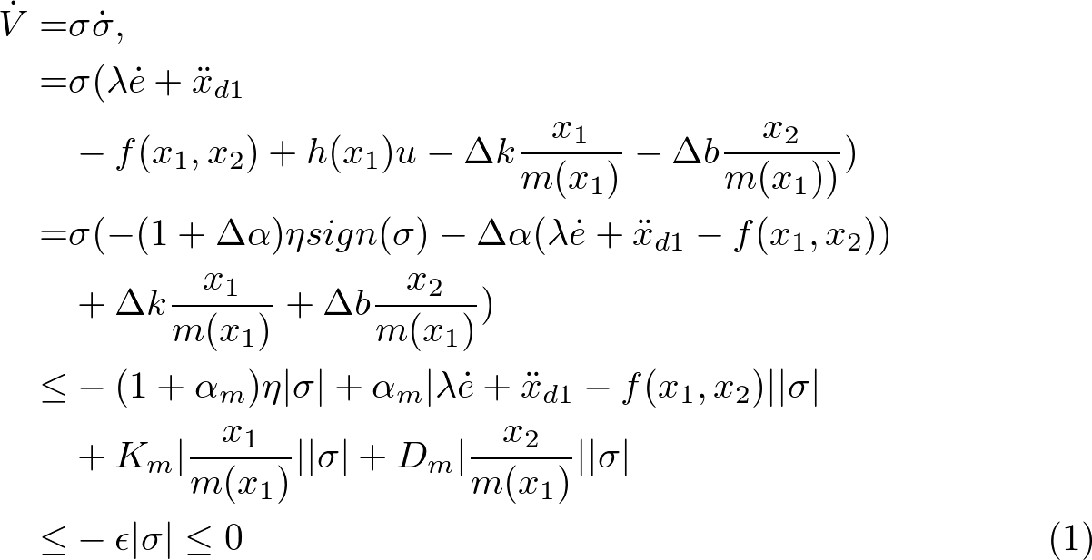
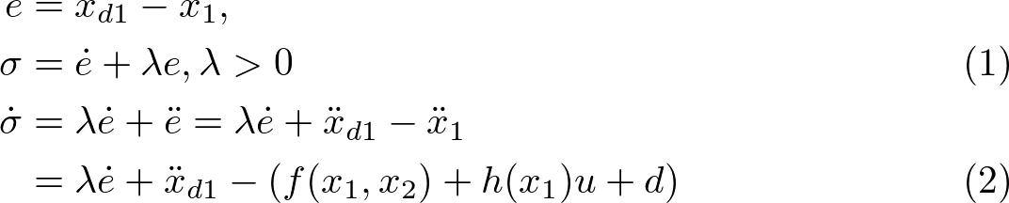

Baseline SMC Design
State space representation
Control input
Stability proof
Sliding surface
Reaching law

Slide 10
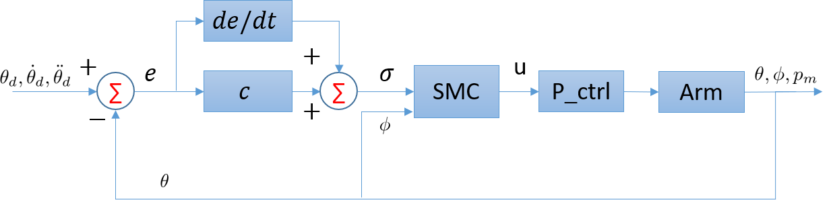
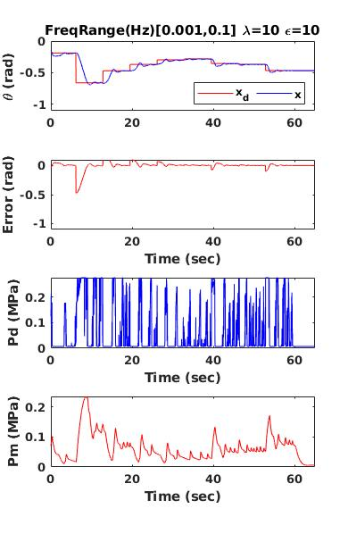
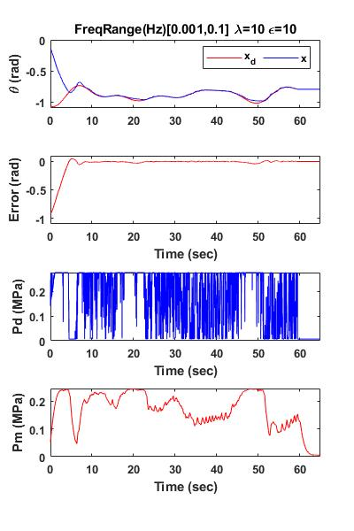
Experimental Results
Experiment setup
Multi-steps signal: Randomly selected in [-10,-40] degrees
Sum-of-sines signal: frequency range [0.001,0.1] Hz
Key findings
Baseline SMC method can track refence signal in both cases
Input chattering needs to be reduced
(Left) Multi-Steps (Right) Sum of sine waves

Slide 11
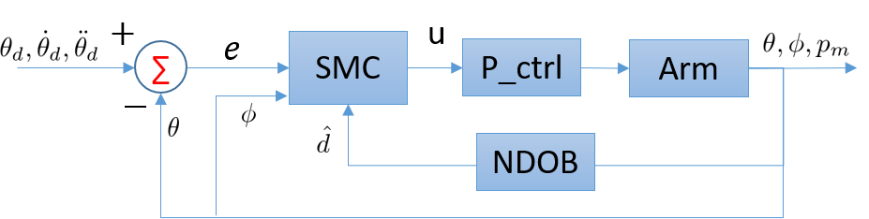
Nonlinear Disturbance Observer
Assumptions
Lumped disturbance is bounded
The time derivative of the lumped disturbance is also bounded
When contacting with environment, the external disturbance is dominant
Goals
Estimate contact force and detect contact event
Stay compliant during the contact and recover back to desired path automatically
Find proper candidate function to ensure the closed-loop system is stable

Slide 12
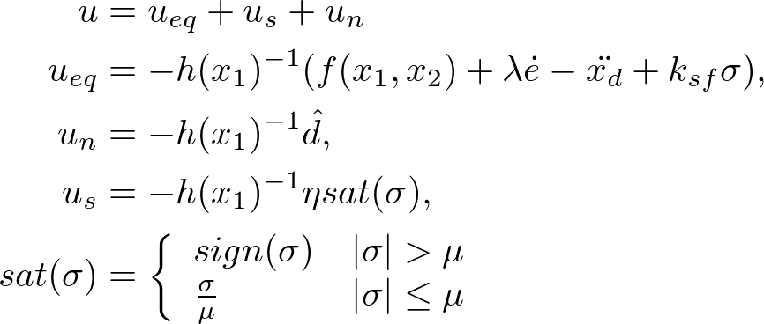
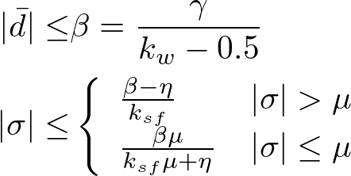
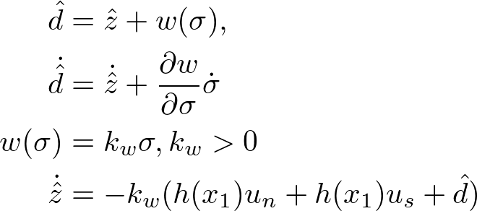
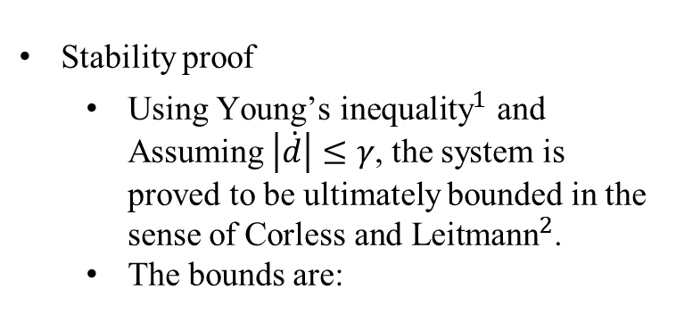
Sliding mode control with nonlinear disturbance observer (SMCNDO)
Redesign control input
Stability proof
Using ${\text{Young}\text{’}\text{s} \text{inequality}}^{1}$ and Assuming $\left|\dot{d}\right|≤γ$, the system is proved to be ultimately bounded in the sense of ${\text{Corless} \text{and} \text{Leitmann}}^{2}$.
The bounds are:
Design of NDOB
Bartle, R.G. and Sherbert, D.R., 2000. Introduction to real analysis (Vol. 2). New York: Wiley.
Corless, M. and Leitmann, G., 1981. Continuous state feedback guaranteeing uniform ultimate boundedness for uncertain dynamic systems. IEEE Transactions on Automatic Control, 26(5), pp.1139-1144.

Slide 13
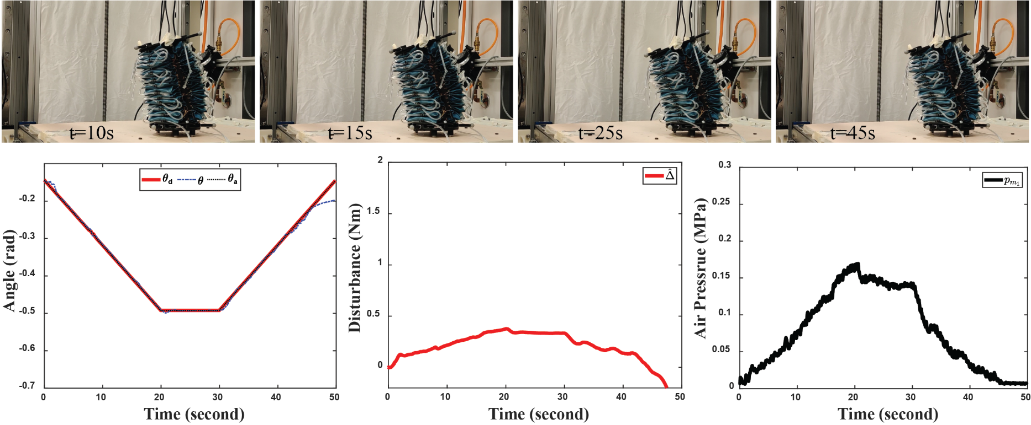
Experimental Results
Experiment setup
Ramp rate: 1 rad/s
No Object in the space
Total of 5 trials
Key findings
SMCNDO can track the desired path
No saturation in chamber pressure

Slide 14
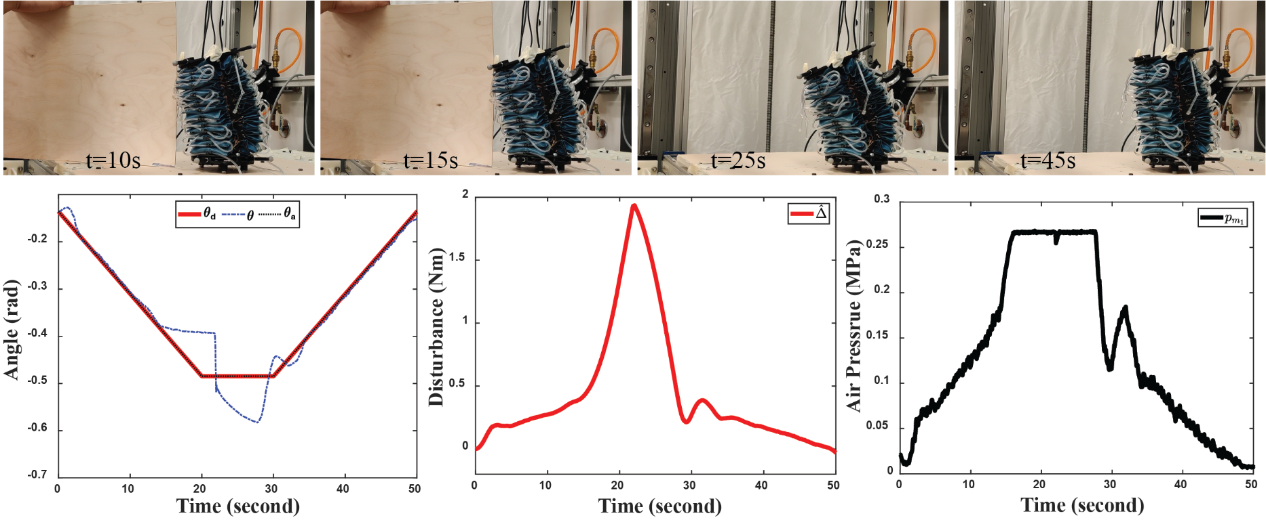
Experimental Results
Experiment setup
Ramp rate: 1 rad/s
Object stay till 22 secs
No further contact
Total of 5 trials
Key findings
SMCNDO can detect the contact
Controller can track the path
High estimated disturbance values
Severe oscillation after contact ends

Slide 15
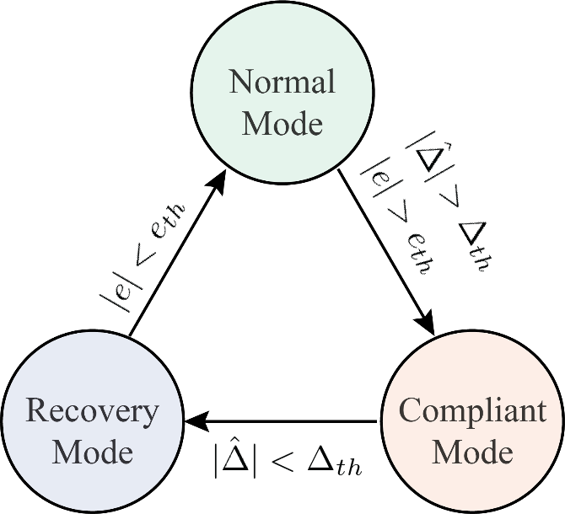
Soft contact with SMCWNDOS
Switch conditions
Normal to Compliant: The estimated lumped disturbance and the tracking error goes beyond the threshold
Compliant to Recovery: The estimated disturbance reduces below the threshold
Recovery to Normal: The tracking error reduces below the threshold
Desired path augmentation:
Normal: original path
Compliant: current position
Recovery: ramp path from the current position to the original path
Assumptions
the system always starts with no contact with the object
The stiffness of the object is higher than the system and the object stays stationary during the contact.
No further contact after the object is removed

Slide 16
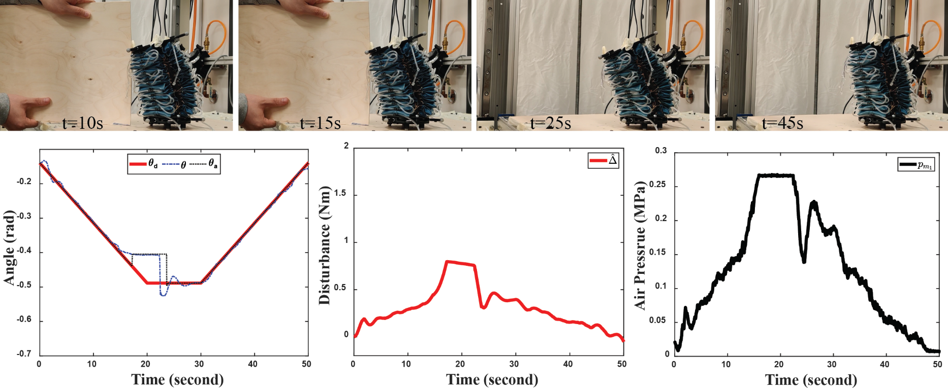
Experimental Results
Experiment setup
Ramp rate: 1 rad/s
Object stay till 22 secs
No further contact
Total of 5 trials
Key findings
SMCWNDOS can detect the contact
Controller can track the path
Low estimated disturbance values
Minimum oscillation after contact

Slide 17
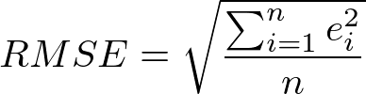
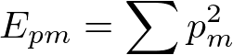
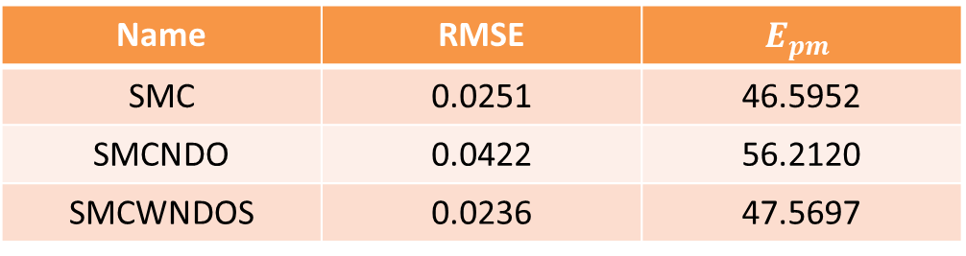
Evaluations of Experiments with Object
Averaged root-mean-square error (RMSE) of position errors
Results
SMC and SMCWNDOS shows similar performance when contact time is short.
SMCWNDOS shows least RMSE values
Averaged energy of the measured air pressures
Name | RMSE | $$E_{pm}$$
SMC | 0.0251 | 46.5952
SMCNDO | 0.0422 | 56.2120
SMCWNDOS | 0.0236 | 47.5697

